Slide 1
Deep Object Co-Segmentation
Weihao Li* , Omid Hosseini Jafari* , Carsten Rother

Slide 2
Introduction (1/2)
Three different co-segmentation challenges:
segment common objects, in terms of small appearance deviation, with varying background.
segment common objects from the same class with low intra class variation but similar background.
segment common objects from the same class with large variability in terms of scale, appearance, pose, viewpoint and (potentially) background.

Slide 3
Introduction (2/2)

Slide 4
Related Work
Co-Segmentation without Explicit Learning.
Co-Segmentation with Learning.
Interactive Co-Segmentation.
Convolutional Neural Networks for Image Segmentation.

Slide 5
Deep Object Co-Segmentation

Slide 6
Method
Given two input images I_{A} and I_{B}, we use a siamese encoder, which consists of convolutional layers, to extract high-level semantic feature maps f_{A} and f_{B}.
Then, we propose a mutual correlation layer to obtain correspondence maps C_{AB} and C_{BA} by matching feature maps f_{A} and f_{B} at pixel-level.
Finally, given the concatenations of the feature maps f_{A} and f_{B} and correspondence maps C_{AB} and C_{BA}, a siamese decoder is used to obtain and refine the common objects masks p_{A} and p_{B}.

Slide 7
Siamese Encoder

Slide 8
Siamese Encoder
extract feature maps f_{A} and f_{B}
encoder is based on the VGG 16-layer network
keep the first 13 convolutional layers and remove the last two fully connected layers fc6 and fc7, which are used for image classification.
replace fc6 and fc7 with two additional 3×3 convolutional layers conv6-1 and conv6-2 to produce feature maps which contain more spatial information.

Slide 9
Mutual Correlation

Slide 10
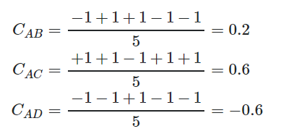
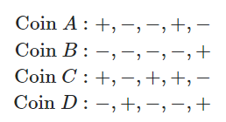
Mutual Correlation (1/2)
compute the correlation between each pair of locations on the feature maps.
the mutual correlation layer performs a pixel-wise comparison between two feature maps f_{A} and f_{B}.

Slide 11
Mutual Correlation (2/2)
Given a point (i,j) and a point (m,n) inside a patch around (i,j), the correlation between feature vectors f_{A}(i,j) and f_{B}(m,n) is defined as
 | c_{AB}(i,j,k)=⟨ f_{A}(i,j),f_{B}(m,n)⟩
where k=(n-j) * D+(m-i) and D×D is patch size.
D=2∗max(w,h)+1
output size = w * h * D²

Slide 12
Siamese Decoder

Slide 13
Siamese Decoder (1/2)
predicts the two foreground masks of the common objects.
The input to the siamese decoder is achieved by concatenating the feature maps f_{A} and f_{B} and their corresponding correlation maps c_{AB} and c_{BA}.
use spatial pooling
The decoder then enlarges the feature maps using deconvolutional layers in order to produce the final object segmentation result.

Slide 14
Siamese Decoder (2/2)
There are five blocks in our decoder, whereby each block has one deconvolutional layer and two convolutional layers.
All the convolutional and deconvolutional layers in our siamese decoder are followed by a ReLU activation function.
By applying a Softmax function, the decoder produces two probability maps pA and pB. Each probability map has two channels, background and foreground, with the same size as the input images.

Slide 15
Loss Function
We define our object co-segmentation as a binary image labeling problem and use the standard cross entropy loss function to train our network. The full loss score LA,B is then estimated by
where the LA and the LB are cross-entropy loss functions for the image A and the image B, respectively.

Slide 16
Group Co-Segmentation
Given a set of N images I={I₁,...,I_{N}}
we use our DOCS network to predict the probability maps for all possible pairs in the image set, P={p^{k}_{n} : 1≤n, k≤N, k≠n}
where p^{k}_{n} is the predicted probability map for image I_{n} when it is paired with image I_{k}

Slide 17
Datasets
PASCAL VOC 2012 dataset
MSCR
Internet
iCoseg

Slide 18
PASCAL VOC 2012 dataset

Slide 19
New co-segmentation dataset
training set : 169.085 image pairs
test : 725 images
validation : 724 images

Slide 20
Training
Caffe framework
PASCAL VOC dataset
The conv1-conv5 layers of our siamese encoder are initialized with weights of a model pre-trained on the Imagenet image classification dataset.
Batch size: 10 image pairs

Slide 21
METRICS
Precision
Jaccard

Slide 22
PASCAL CO-SEGMENTATION DATASET
93.78% for Precision and 57.82% for Jaccard

Slide 23
MSRC DATASET (1/2)

Slide 24
MSRC DATASET (2/2)

Slide 25
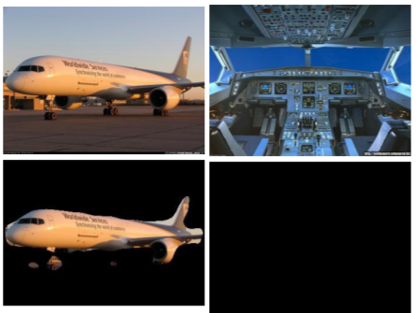
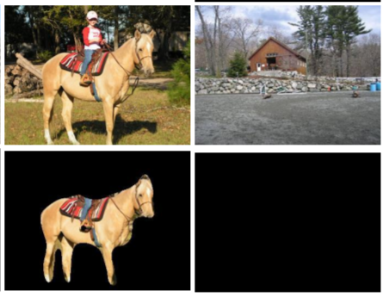
INTERNET DATASET (1/2)

Slide 26
INTERNET DATASET (2/2)

Slide 27
iCoseg Dataset (1/2)

Slide 28
iCoseg Dataset (2/2)

Slide 29
Q&A

